Slide 1

Group 101: Software engineering
Fee kim, Emily, sara, Maneesh, simardeep
Sprint 5

Slide 2
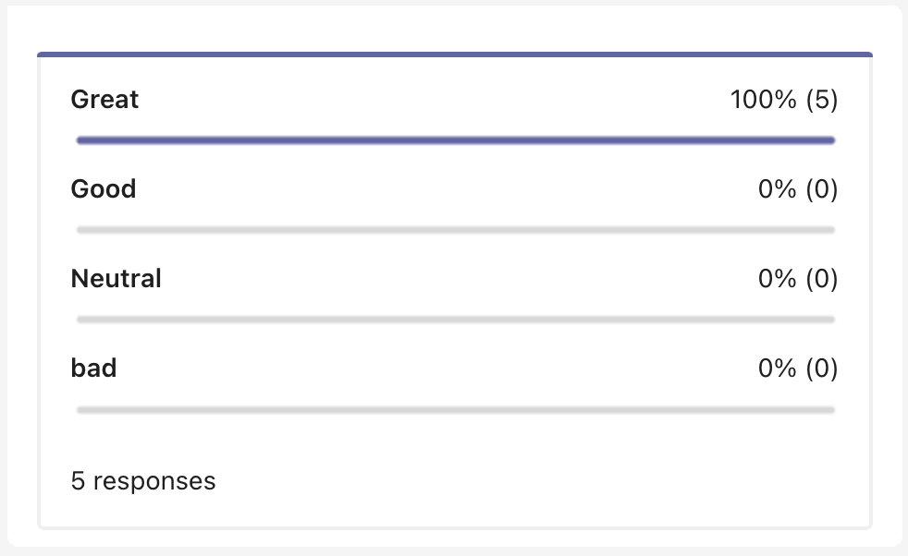

TEAM’s OVERALL thoughts on sprint 5

Slide 3
How did the sprint go?
WHAT WENT WELL
Communication: Lots of communication from beginning to end through team meetings and chats. Once a sprint is done, we just dive into the next.
Task Completion: working together when anyone of us is having issues and we manage to get the sprint completed well before the deadline.
Consistency: Assigned issues are completed on time
AREAS OF IMPROVEMENT
More team programming in future sprints

Slide 4
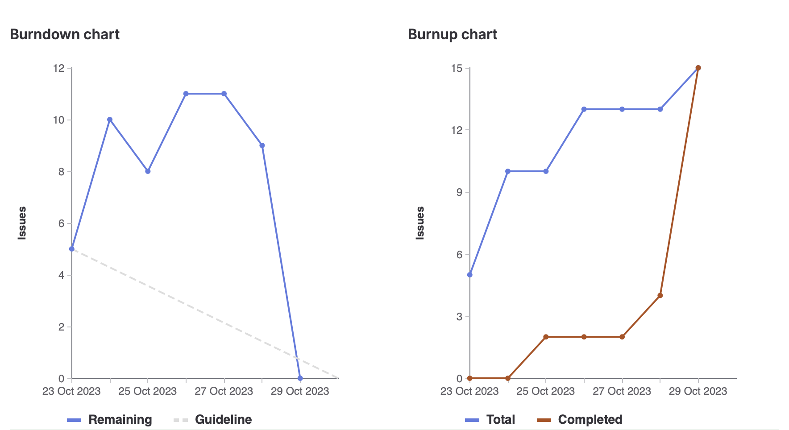
Burndown charts

Slide 5
Fee Kim → 22 weights
Team Lead for Sprint 5
Got to lead the team, plan the sprint and team meetings
Got to document the sprint and improve the PUT endpoint
HIGHLIGHT:
Experience the role of being a team lead and it was great with such an incredible team

Slide 6
Emily → 19 weights
Worked on getting the API document on our website.
Added a button on the homepage that we’ll get you to the API document.
HIGHLIGHT:
Working with the front-end to make documentation accessible on the website

Slide 7
Maneesh →20 weights
Worked towards fixing the API document
Improved the GET endpoints to use logical AND and logical OR
HIGHLIGHT:
figuring out how to handle AND and OR cases when fetching prerequisites in order to make our API more robust

Slide 8
Sara → 20 weights
Implemented the GET endpoints to get subjects and to get by subjects
HIGHLIGHT:
Creating my very first API endpoint!

Slide 9
Simardeep – 19 weights
Worked towards improving our POST endpoint so that it can handle more errors
HIGHLIGHT:
Worked on improvement of post api endpoint

Slide 10
DEMO time

